Slide 1

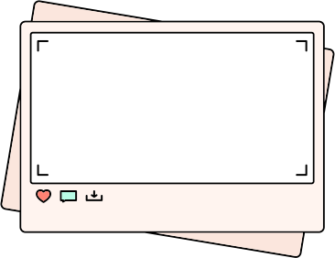
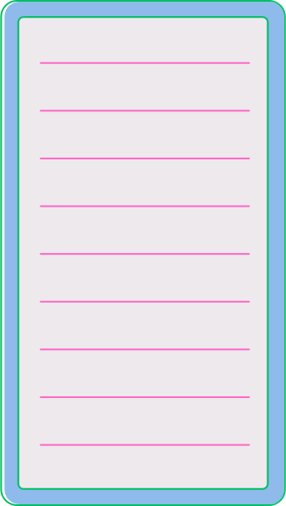
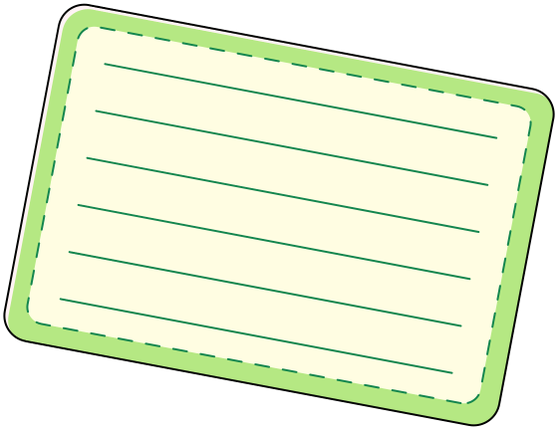

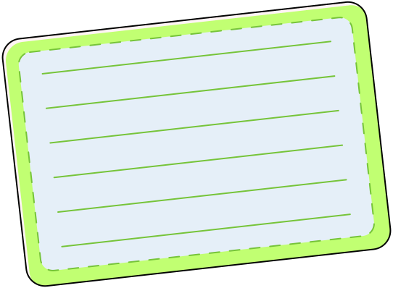
LGMD
Limb Girdle Muscular Dystrophy

Slide 2
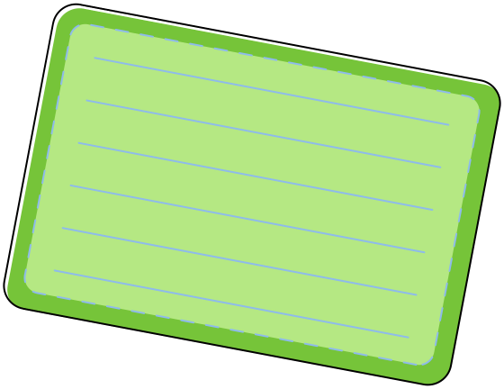
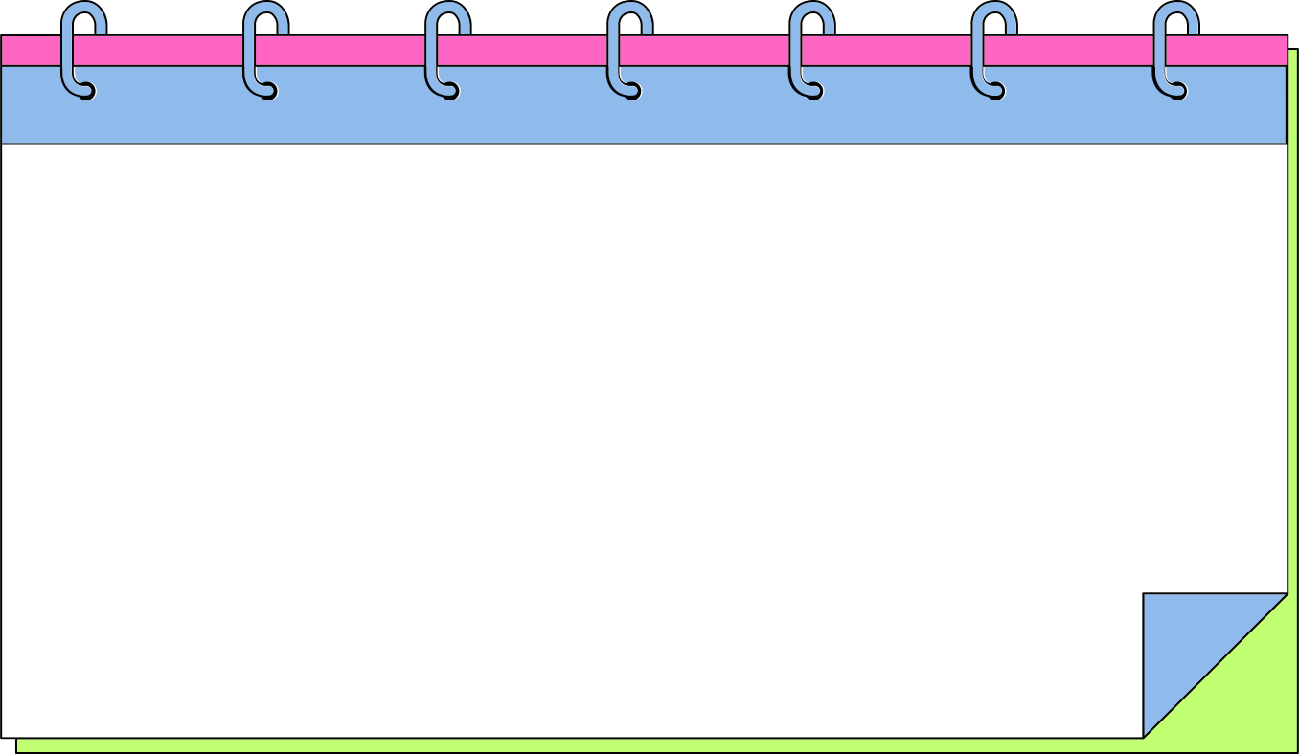
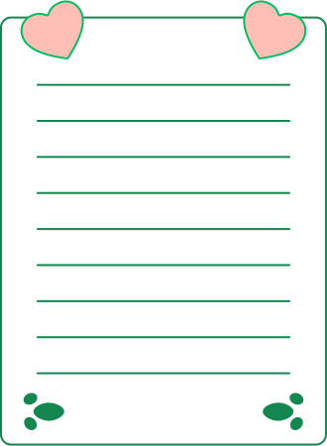

HOW OUR MUSCLES WORK
Skeletal muscles are the ones attached to our bones.
They help us move, whether we’re running, jumping, or
even smiling.
We control them, they don’t move on their own.
Fun Fact- There are over 600 muscles in your body!

Slide 3
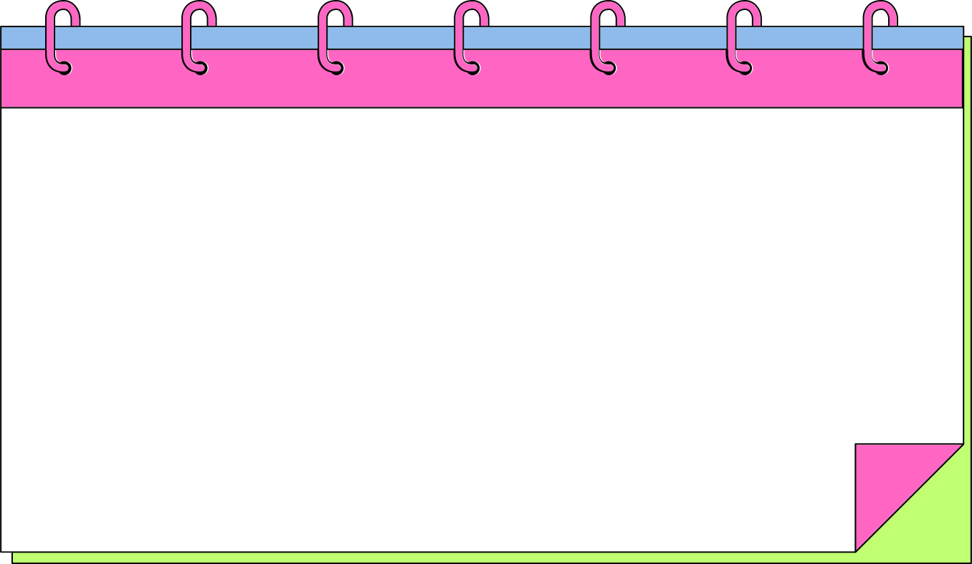
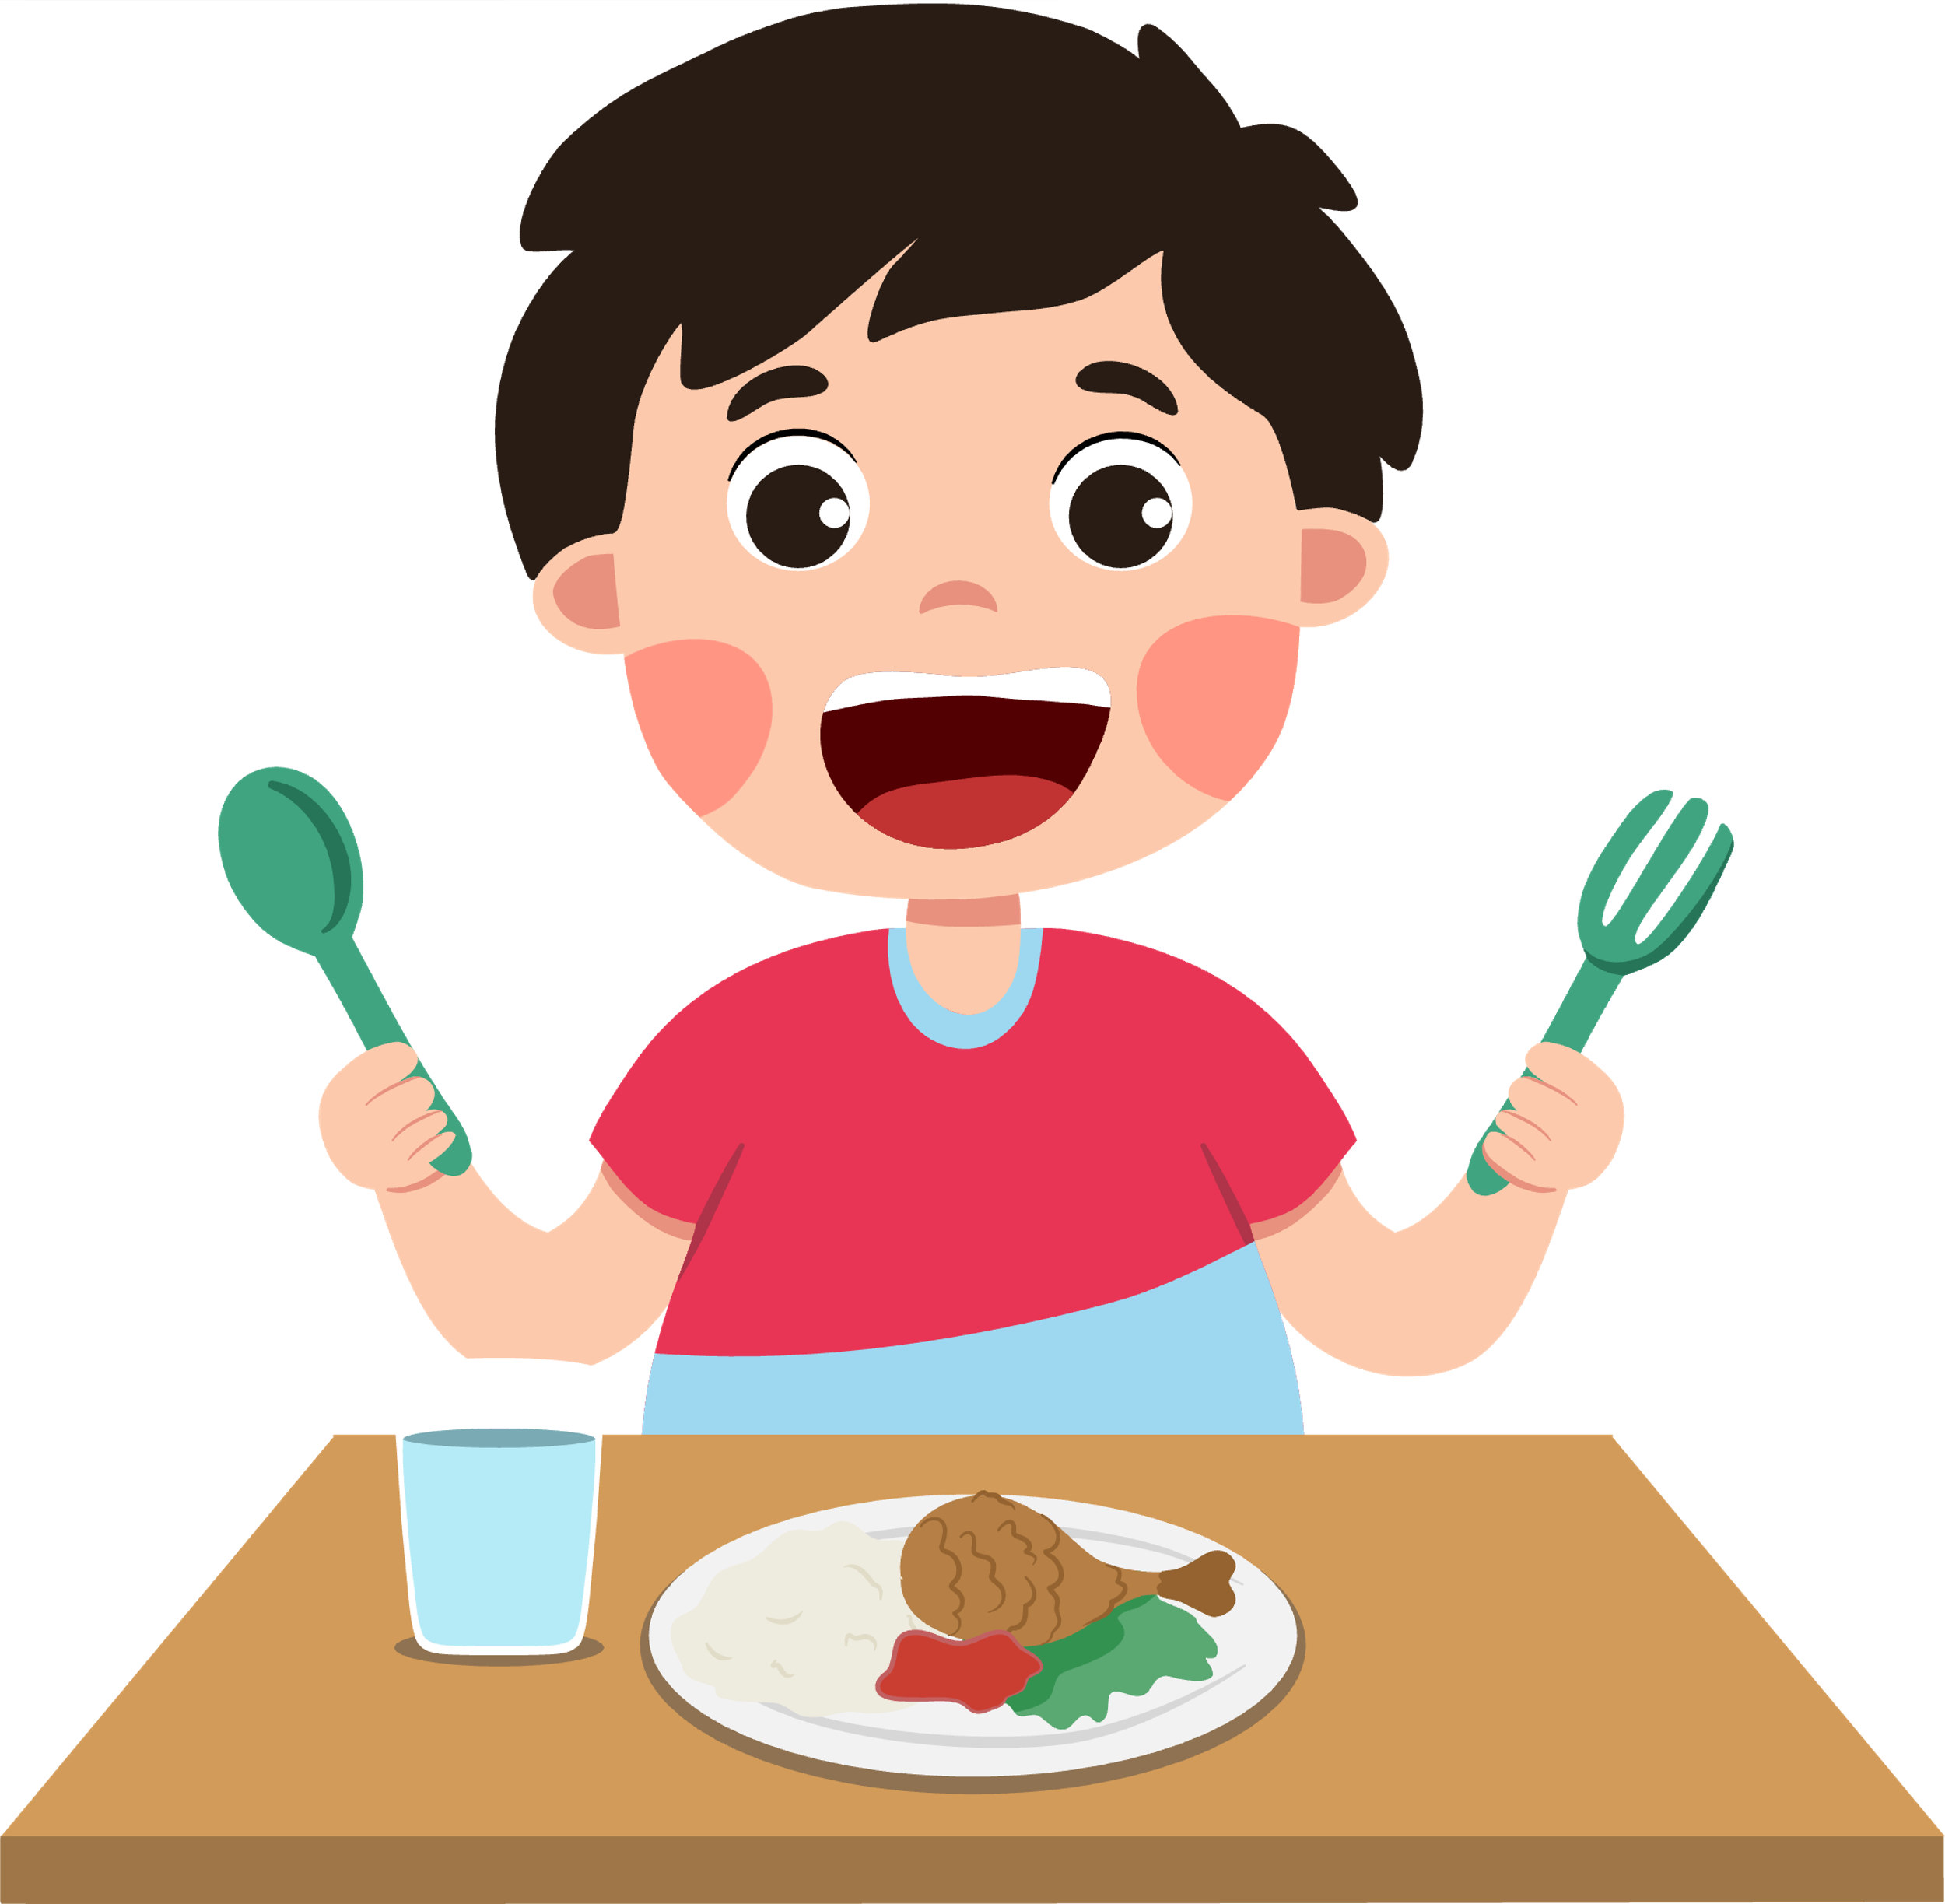
HOW WE USE OUR MUSCLES
Muscles need fuel (energy) from the food we eat.
Healthy foods like fruits, vegetables, grains, and protein give muscles power.
Muscles + Food = A SUPER TEAM!

Slide 4

HOW OUR MUSCLES WORK
How do muscles repair themselves?
When we play or exercise, tiny “tears” happen in our muscles.
With rest, sleep, and healthy food, muscles fix themselves.
Repaired muscles grow stronger than before!

Slide 5

HOW WE USE OUR MUSCLES
For each example put your thumbs up if you think you use your muscles to do the activity and thumbs down if you do not.

Slide 6
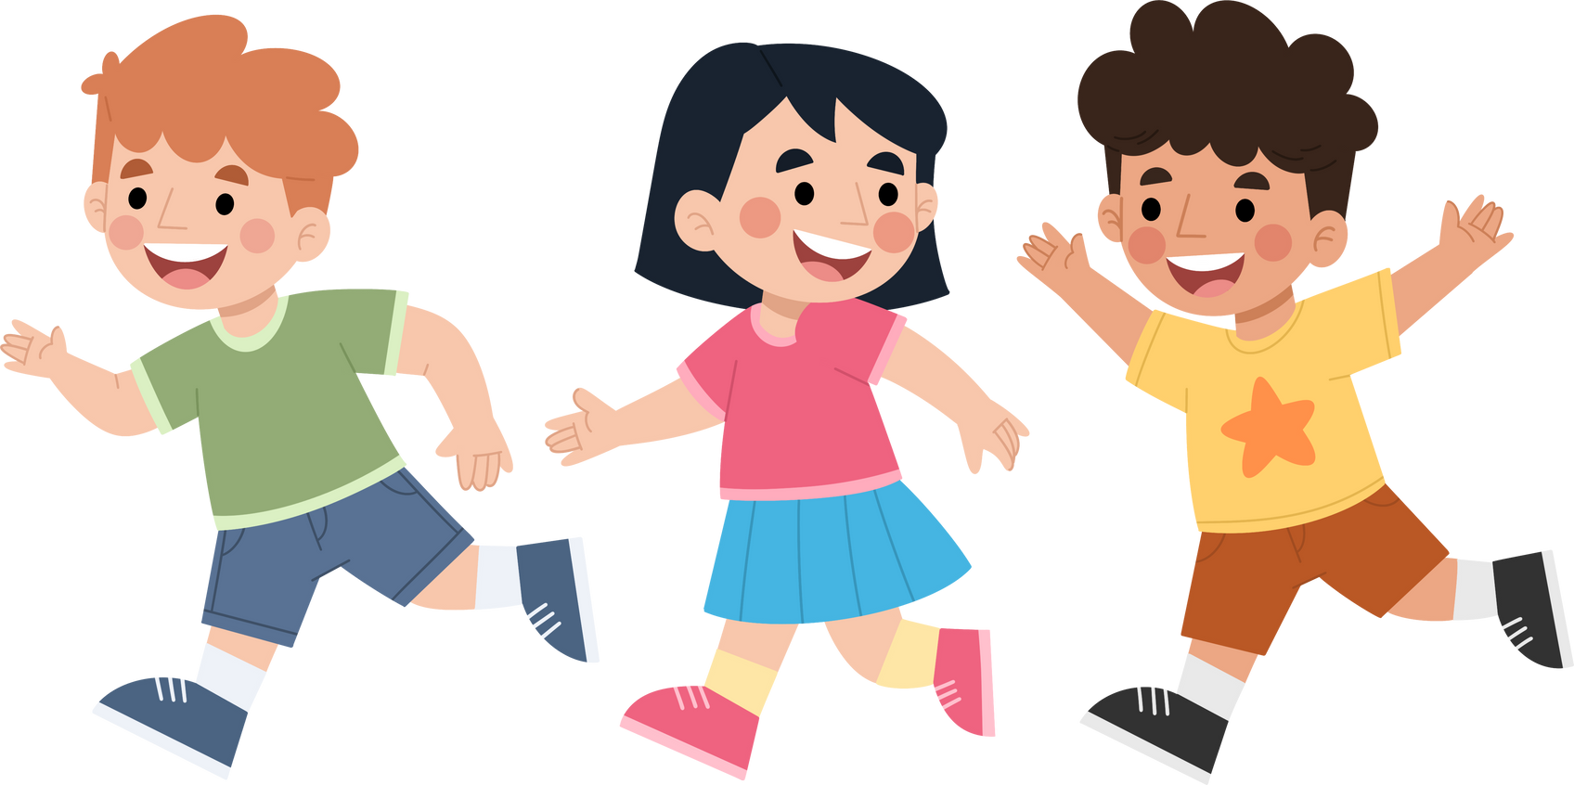
HOW WE USE OUR MUSCLES

Slide 7

HOW WE USE OUR MUSCLES

Slide 8
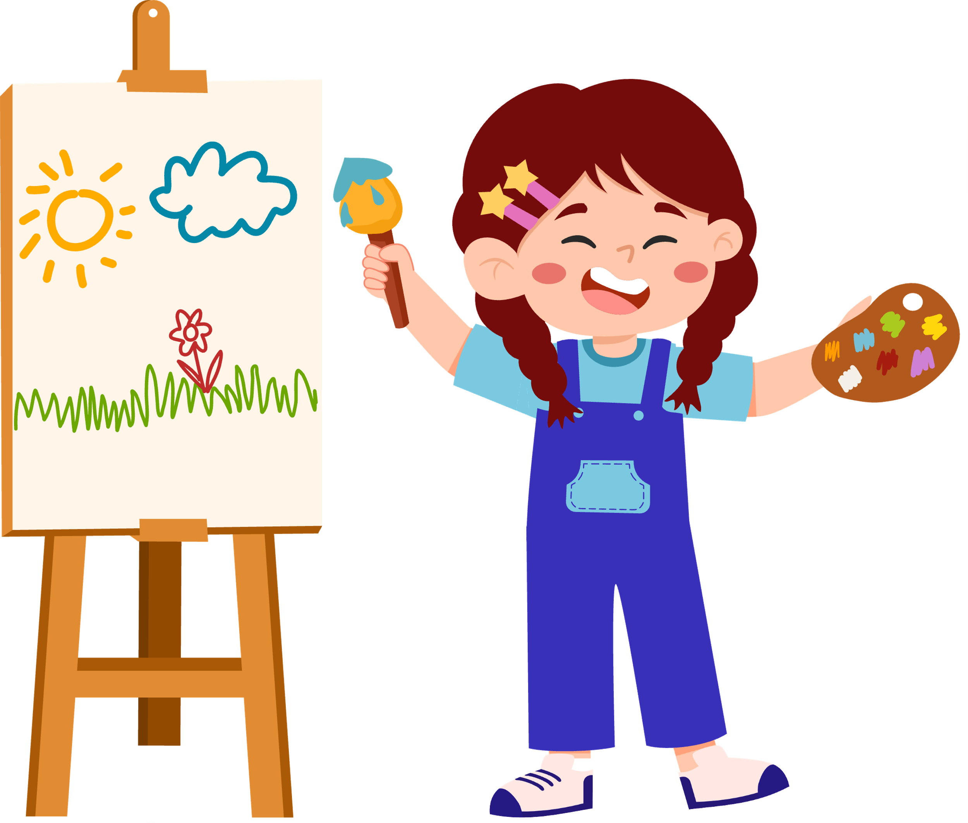
HOW WE USE OUR MUSCLES

Slide 9
HOW WE USE OUR MUSCLES

Slide 10
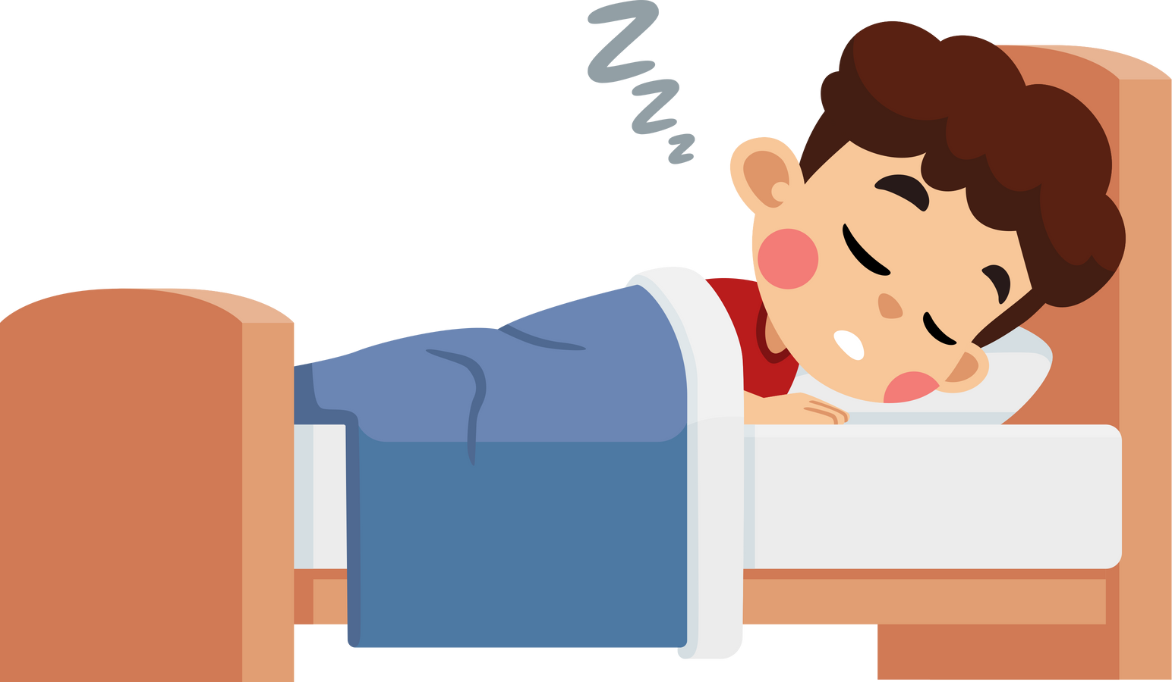
HOW WE USE OUR MUSCLES

Slide 11
HOW WE USE OUR MUSCLES

Slide 12
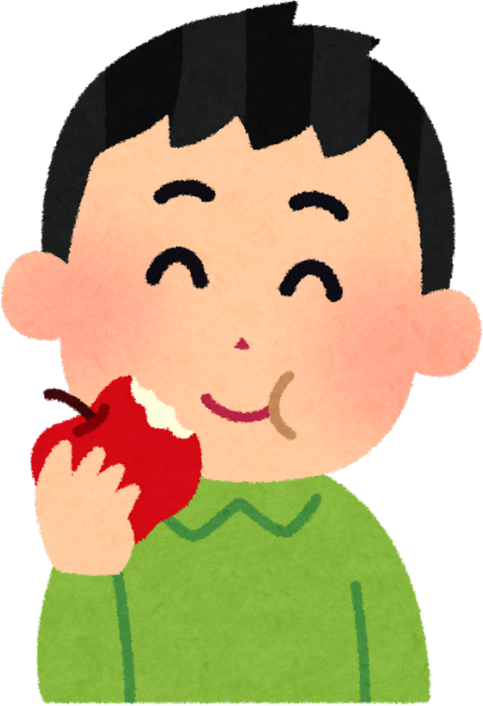
HOW WE USE OUR MUSCLES

Slide 13
HOW WE USE OUR MUSCLES

Slide 14
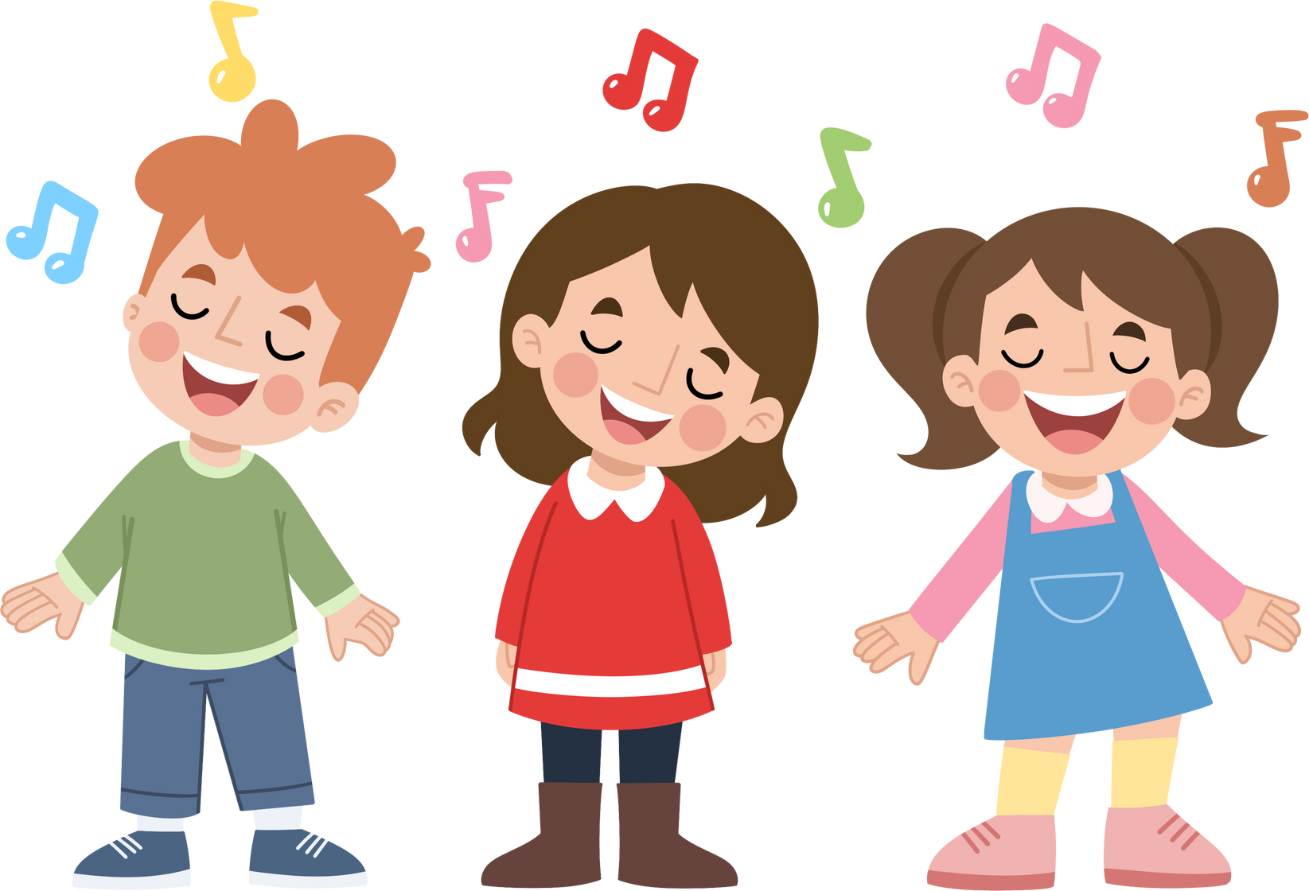
HOW WE USE OUR MUSCLES

Slide 15
HOW WE USE OUR MUSCLES

Slide 16

HOW OUR MUSCLES WORK
Wow, our muscles are a very important part of our body!
Our muscles are working both while we are awake and sleeping.
Even breathing and blinking use muscles!
Some movements use large skeletal muscles while cardiac muscles keep our hearts beating!

Slide 17
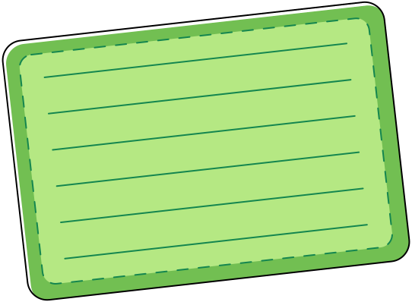


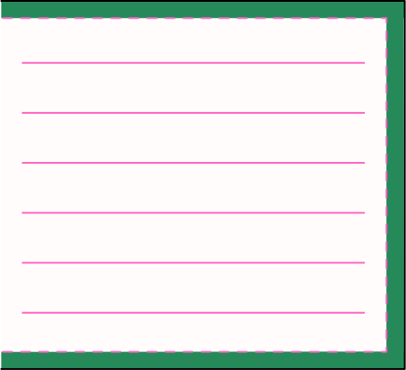
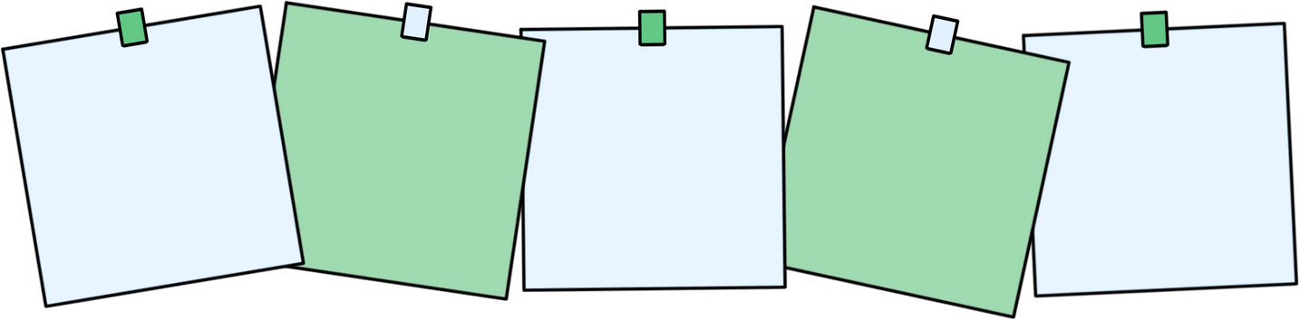
LGMD
There are over 30 types of Limb-Girdle Muscular Dystrophy.
It happens because a special “muscle helper protein” is missing or doesn’t work the way it should.
Without this helper, muscles can’t repair and grow strong like they’re supposed to.
Over time, this can make walking, running, climbing, or lifting things harder.

Slide 18

LGMD
Think of Muscles like a LEGO Tower
Most people’s muscles are like towers that can be taken apart and rebuilt stronger.
With LGMD, the “LEGO pieces” don’t always fit back together the same way, so the tower becomes a little weaker.

Slide 19

WE ARE ALL UNIQUE
Everyone has things they are really good at.
Everyone has things that might be a little harder for them.
That’s what makes us special and unique!
✨ Fun fact: Even your fingerprint is one-of-a-kind—just like YOU.

Slide 20
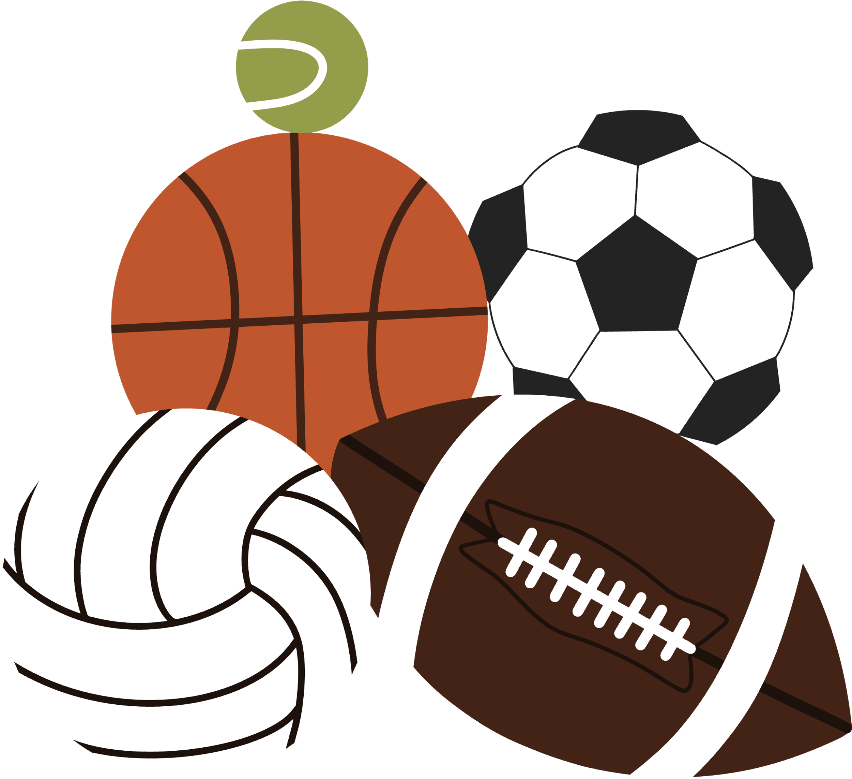
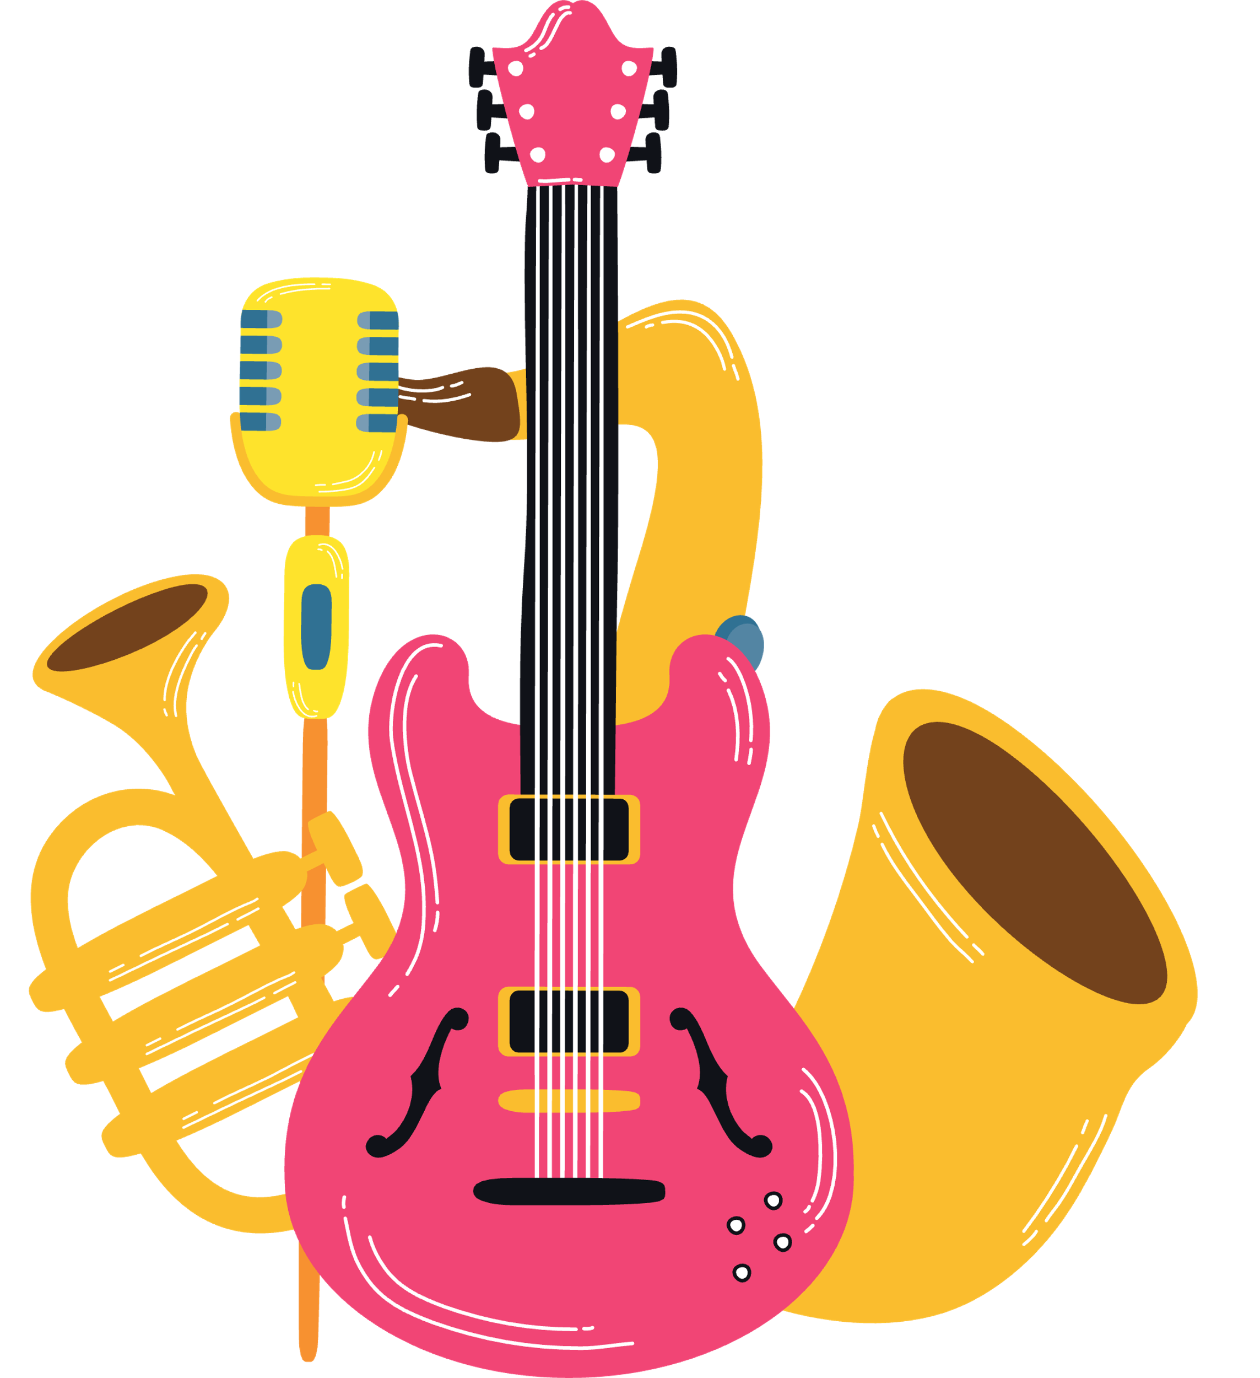
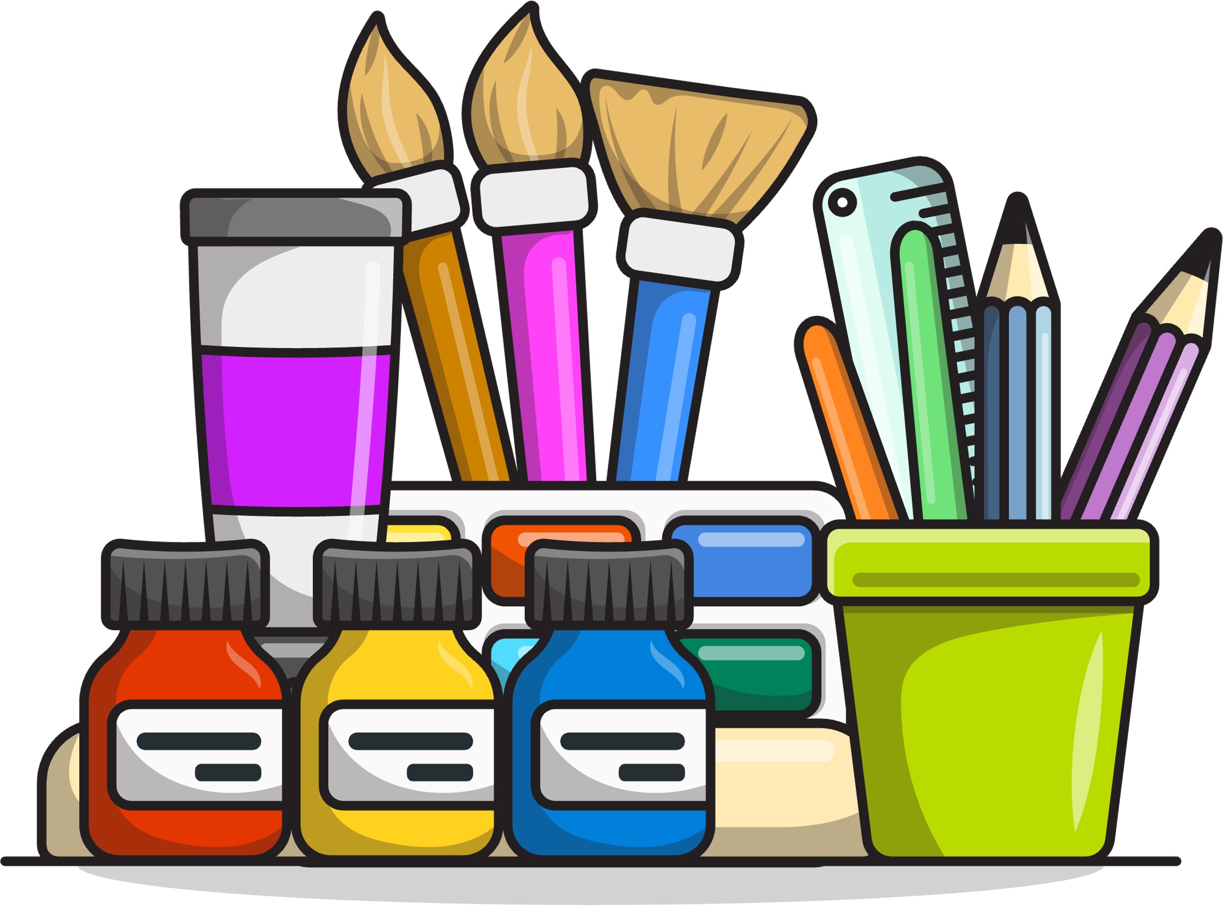


WE ARE ALL UNIQUE
Turn to the person next to you and share:
2 things that you are really good at
2 things that you are a bit harder for you

Slide 21


DIFFERENT WAYS SAME PLAY
Some kids may use a wheelchair or walker to get around.
Some may need to take breaks when their muscles get tired.
Some might need a little extra help in class or on the playground.
Some may need more time to finish an activity.
✨ But no matter what—everyone wants to have fun, learn,
and make friends!

Slide 22
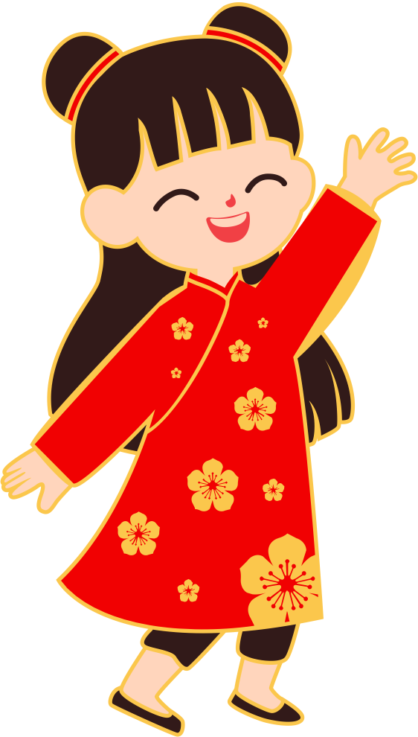
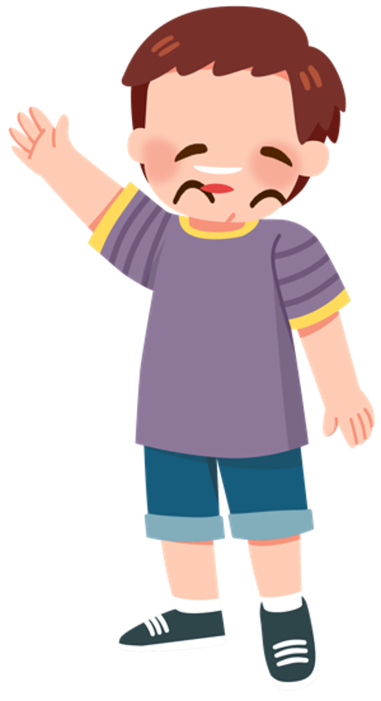
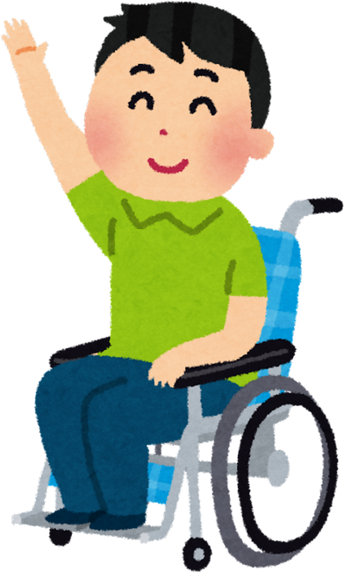
HOW CAN WE BE SUPPORTIVE
Be patient if a friend needs more time.
Offer to help, but remember, it’s okay if they say no.
Include everyone in games, even if they play in a different way.
Celebrate each other’s efforts and talents!

Slide 23
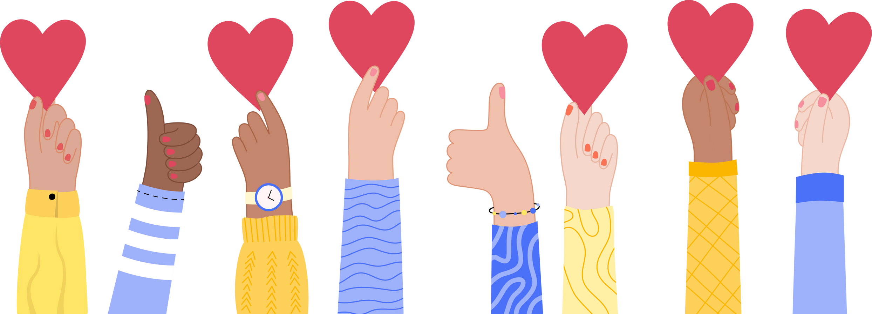
WE ALL BELONG
When we choose kindness, patience, and friendship, we make our classroom and playground a place where everyone belongs.

Slide 24
CREDITS
Lesson created by Cure LGMD2i Canada Foundation
Graphics and design elements used under Canva Pro License.
Some illustrations from Canva contributors via Canva Pro.

