Slide 1

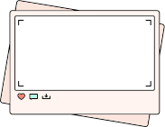


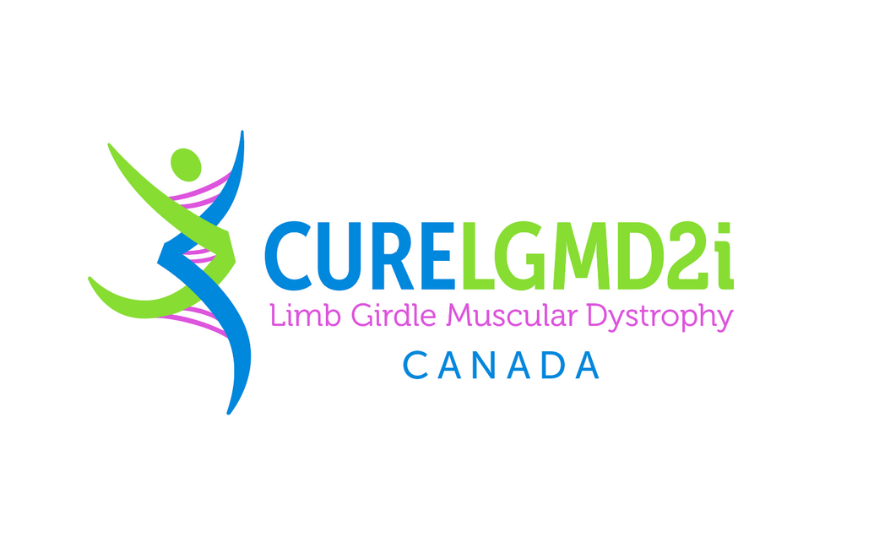

LGMD
Limb Girdle Muscular Dystrophy
The Science of Muscles and Genes
For Grades 4-6

Slide 2

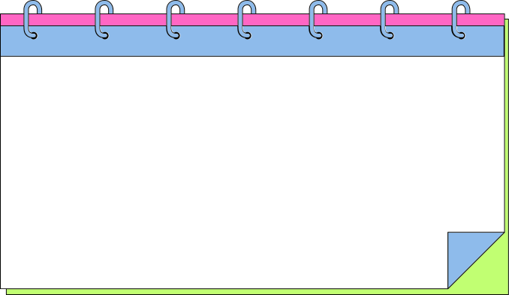

LET’S TALK ABOUT MUSCLES
Flex your arm and while you do, feel your muscles.
1. What do muscles do?
2. Why do we need them?
3. Where are muscles found in our bodies?

Slide 3

WHAT DO MUSCLES DO?
Muscles are the parts of our body that help us move and do things. They pull on our bones so we can walk, run, jump, smile, and even breathe! Muscles also help hold our body up and protect our organs.
Some muscles work when we tell them to, like when we pick up a pencil, and others work all the time without us thinking
about it, like our heart or the muscles that help us breathe.

Slide 4
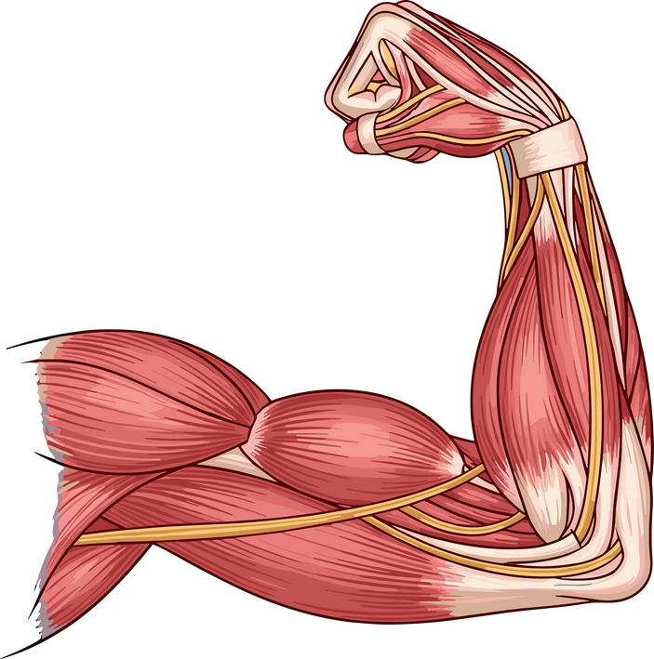
WHY DO WE NEED MUSCLES?
1. They Help Us Move
Muscles are what make movement possible.
They’re attached to our bones by strong cords called tendons.
When a muscle tightens (contracts), it pulls on the bone. That’s how we bend our arm, kick a ball, or smile.
Example: When you pick up a pencil, the muscles in your
arm tighten to lift it, and when you put it down, they relax
again.

Slide 5
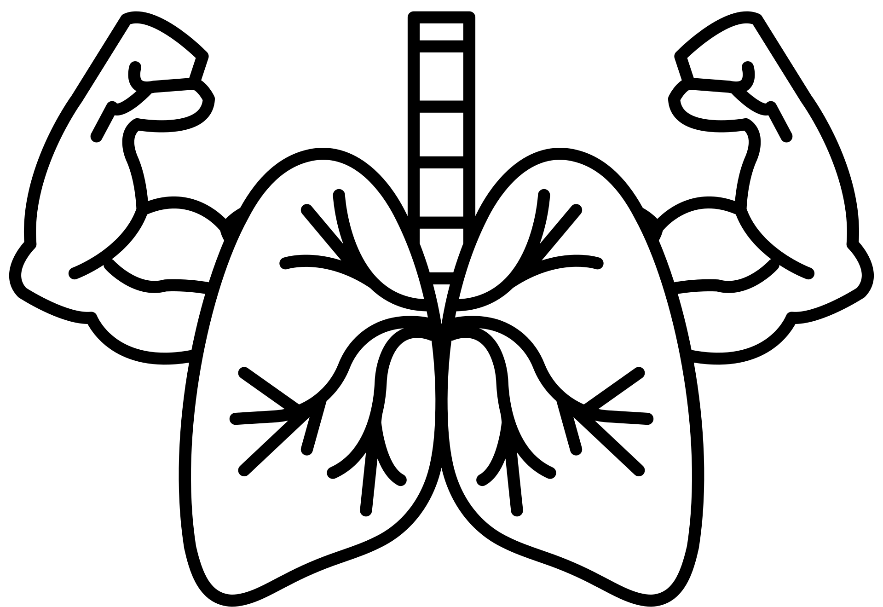
WHY DO WE NEED MUSCLES?
2. They Keep Us Alive
Some muscles never stop working, even when we’re sleeping!
These are involuntary muscles, which means we don’t control them on purpose.
The heart is a muscle that pumps blood through our body every second of the day.
The muscles in our stomach and intestines help move food so we can digest it.
The diaphragm (a big muscle under our lungs) helps us breathe.
Without these muscles, we couldn’t live.

Slide 6

WHY DO WE NEED MUSCLES?
3. They Help Us Stand and Stay Stable
Muscles are what make movement possible.
Muscles don’t just move us - they hold us up!
Even when you’re standing still, lots of small muscles are
working to keep you balanced so you don’t fall over.
These are called postural muscles, they help you sit up
straight, hold your head up, and stay strong.

Slide 7
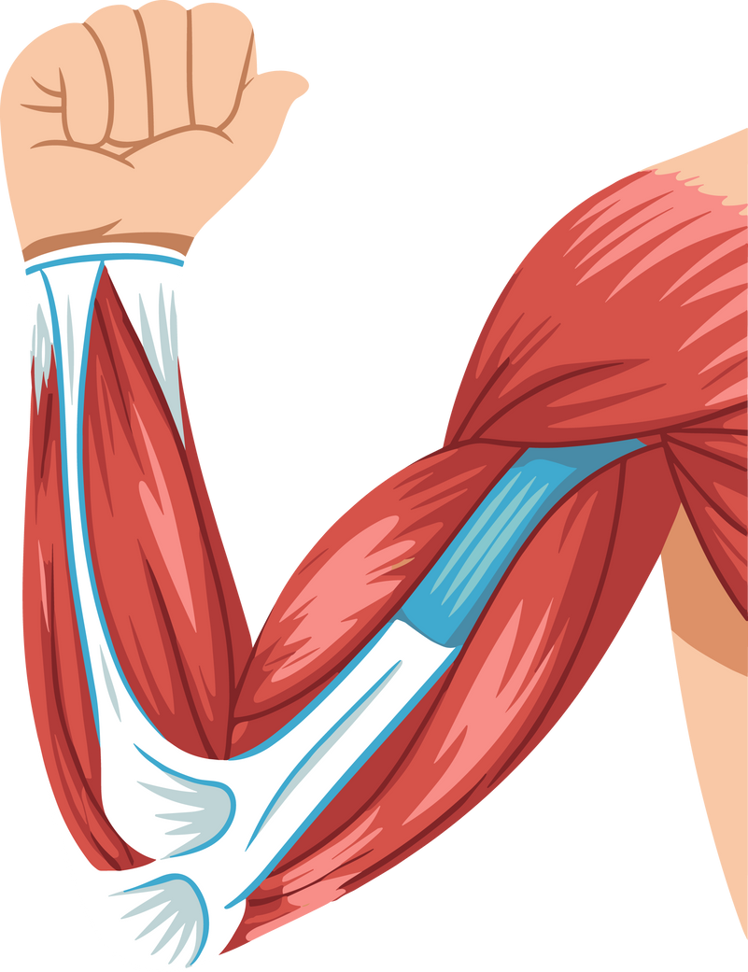
WHERE ARE MUSCLES FOUND?
1. Skeletal Muscles
Attached to your bones with tendons.
They help you move — like walking, jumping, or waving.
You can control them (these are your voluntary muscles).
Examples: biceps, triceps, leg muscles, shoulder muscles.

Slide 8
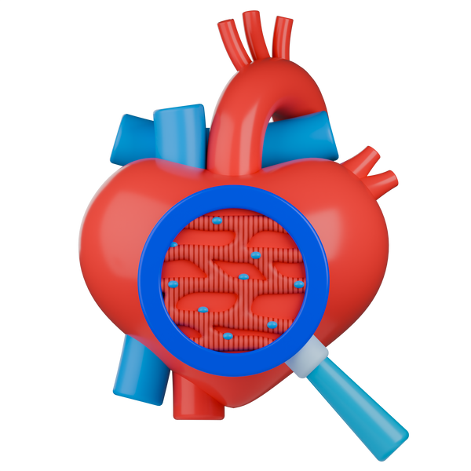
WHERE ARE MUSCLES FOUND?
2. Cardiac Muscle
Found only in your heart.
It works all day and night to pump blood through your body.
You can’t control it — it works automatically!

Slide 9
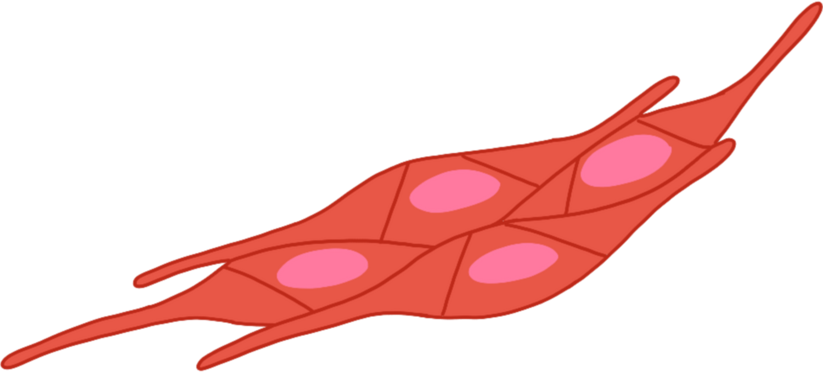
WHERE ARE MUSCLES FOUND?
3. Smooth Muscles
Found inside your stomach, lungs, intestines, and blood vessels.
They move things through your body, like food and air.
Also work automatically without you thinking about them.

Slide 10

HOW DO OUR BODIES MOVE?

Slide 11

WHAT ARE GENES?
Our genes are like instruction books that tell our bodies
how to grow and work.
Every person has thousands of genes inside almost every cell in their body.
Genes are made of DNA, which looks like a twisted ladder
called a double helix.

Slide 12
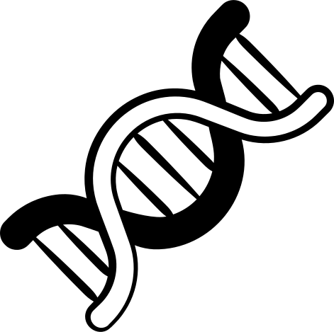
WHAT ARE GENES?
The “steps” of the ladder are made of a special code using only four letters (A, T, C, G).
These letters form instructions for how our bodies build proteins — the things that make up muscles, bones,
skin, and even our blood.

Slide 13

WHAT IS A GENE MUTATION?
Think of your genes like a recipe book. If one letter or ingredient is missing or mixed up, the recipe might still work — but it could taste or look a little different. When a gene has a change like that, it’s called a “mutation.”

Slide 14
GENETIC MUTATIONS
If one of those instructions changes through a mutation, the protein may not work the way it should.
Sometimes, a gene mutation doesn’t cause any problems at all and you don’t even know about it.
But other times, it can make certain parts of the body, like muscles, work differently.

Slide 15

MUTATIONS AND LGMD
With Limb-Girdle Muscular Dystrophy (LGMD), a change in a muscle gene affects how the muscle builds or repairs itself.
It doesn’t affect a person’s personality. It just affects how their muscles work.

Slide 16
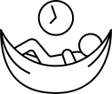
MUTATIONS AND LGMD
Over time, people living with LGMD may notice that their muscles become weaker, especially around the hips, shoulders, and legs.
Due to this, they might get tired more quickly and need extra time to rest and recharge.
After being active, it can take longer for their muscles to recover and repair, which is why pacing and rest are
so important.

Slide 17

HOPE IN SCIENCE
Scientists and doctors are working hard to learn more about LGMD.
They are studying ways to:
Fix or replace the gene that causes muscle weakness
Develop new medicines to protect and strengthen muscles
Use physiotherapy and exercise to help people stay active and healthy
Every new discovery brings hope for stronger muscles
and a brighter future for people living with LGMD.

Slide 18

HOW CAN WE BE SUPPORTIVE
Be patient if a friend needs more time.
Offer to help, but remember, it’s okay if they say no.
Include everyone in games, even if they play in a different way.
Celebrate each other’s efforts and talents!

Slide 19




WE ALL BELONG
When we choose kindness, patience, and friendship, we make our classroom and playground a place where everyone belongs.

Slide 20
CREDITS
Lesson created by Cure LGMD2i Canada Foundation
Graphics and design elements used under Canva Pro License.
Some illustrations from Canva contributors via Canva Pro.

